Slide 1
Interest-free Agriculture E-Credit Scheme “Empowerment of Kissan through Financial & Digital Inclusion” by
DR AMJAD SAQIB
25-11-2018

Slide 2
Salient Features
Akhuwat – Interest-free Agri Loans
Interest free Loan (Financial Inclusion)
Digital Inclusion
Productive Networking
Technological Inclusion
Skill Enhancement
Social Inclusion

Slide 3
Objective of Project
The objective is to
Promote the wellbeing of small farmers through provision of interest free and easy access to financing
Reduce the cost of production for these marginalized farmers
Increase the outreach of formal and digital financial services to ensure financial inclusion

Slide 4
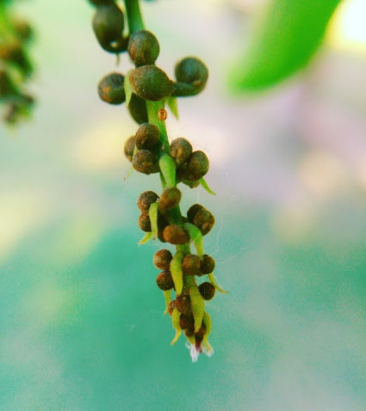
Loan Process
1. Program Introduction
3. Application submission by potential borrowers
9. Loan Approved by Loan Approval Committee
14.Regular visits of field
6.Agriculture Appraisal by staff
5.Social Appraisal by staff
7.Guarantors of Loans
(to be provided by farmers)
15.Recoevry of Loan
2. LRMS Verification/
Registration
4.Selection of farmers on PITB portal
10.Final Approval from Agri. Dept.
11.Asaan Account
13. Social guidance & paper Disbursement
12.Smart phones and mobile wallets
8.Finalization of documents
Agri. E-Credit Scheme

Slide 5
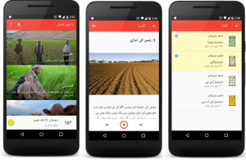
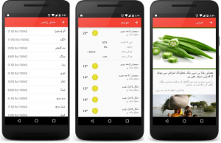
Digital Inclusion
Opening of bank accounts of farmers
Cashless disbursement
Use of ATM card for cash withdrawal
Use of mobile wallet account for cash withdrawal and vendor payments
Inclusion of smart phones for:
Agriculture advisory
Weather forecast
Knowledge about latest machinery
Market information
Helpline number
Agriculture news

Slide 6
Progress as of November, 2018
%age Recovery
99.96%
No. of Districts
22
No. of Branches
82
Total Loans
114,471
Amount Disbursed (Rs)
6.310 Billion
Active Loans
11,032
Outstanding Loan Portfolio (Rs)
681 Million
Total benefited farmers
53,004

Slide 7
Major Achievements
Agreed terms in MoU
Services provided in addition to MoU
114,471 loans to 53,004 farmers
28,000 farmers got smart phones with wallet account
Community Organizations formed
35,000 farmer got training on latest techniques
Water & Soil test now essential
Laser leveling is now included in routine
38,000 bank accounts of farmers opened
Crop insurance started as pilot
164,271 trees planted in August 2018
Ushar committees
Farmers’ Linkages with private sector, 25,000 farmers
Regular monitoring of farms’ production

Slide 8
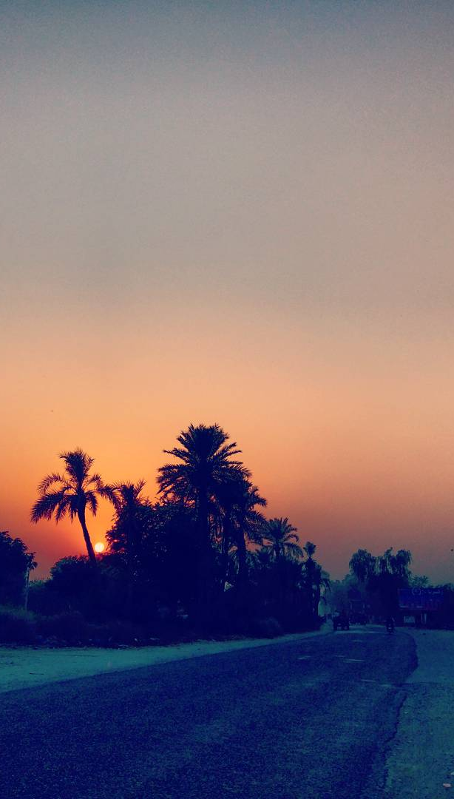
Farmers’ Road to Success
Start
Land
Seeds & Fertilizers
Soil & Water Testing
Laser Leveling
Technology
Elimination of Middleman
Access of Interest Free Financial Services
Trainings about latest tools and techniques
Crop
Increased crop production
Improved Income
Farmer is free to sale crop in market

Slide 9
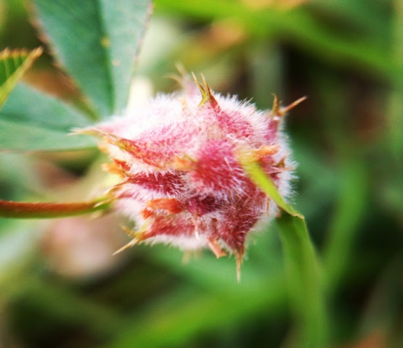
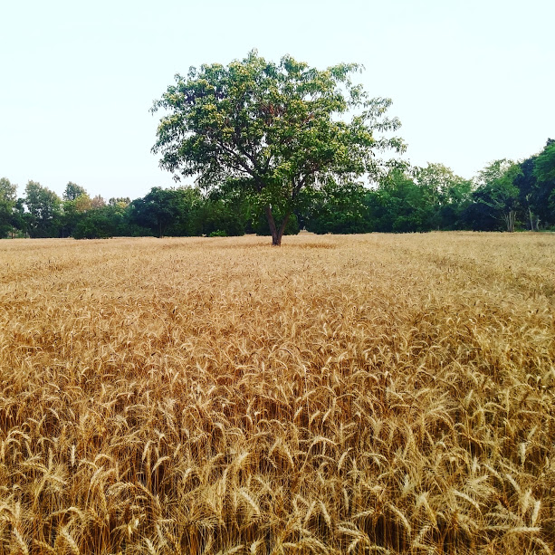
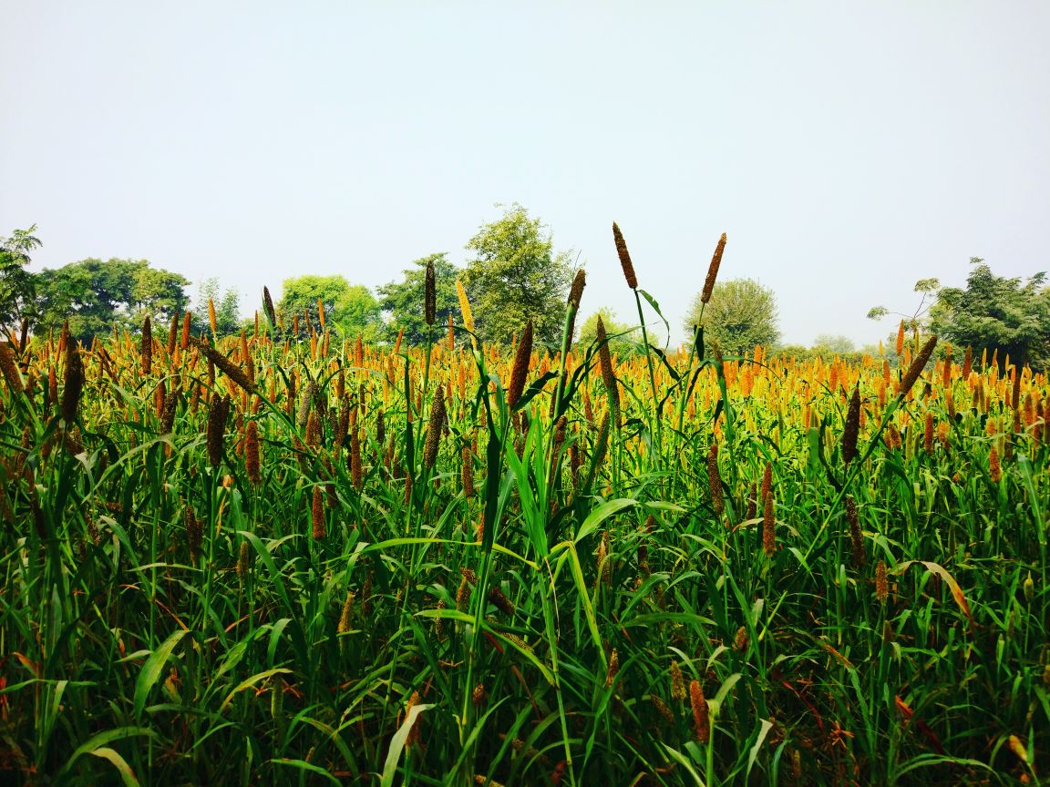
THANK YOU

